Slide 1
Ding Dong, Pizza!
Euna Byun (Group 3)
VR Lab - Virtual Reality for Industrial Application (IP 426)

Slide 2
TABLE OF CONTENTS
02
03
04
01
Description
3D Modeling
Motorcycle Driving
VR Functions

Slide 3
1. Description
Motivation - Motorcycle
Provide a more dramatic experience for players
Make VR reality well realized
Target Audience
- Gamers who want to experience VR motorcycle driving

Slide 4
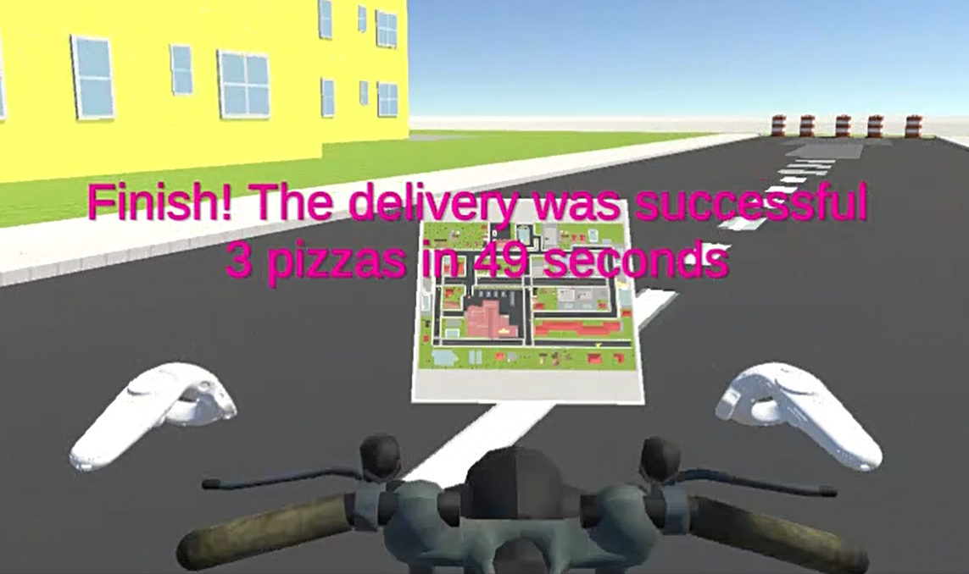
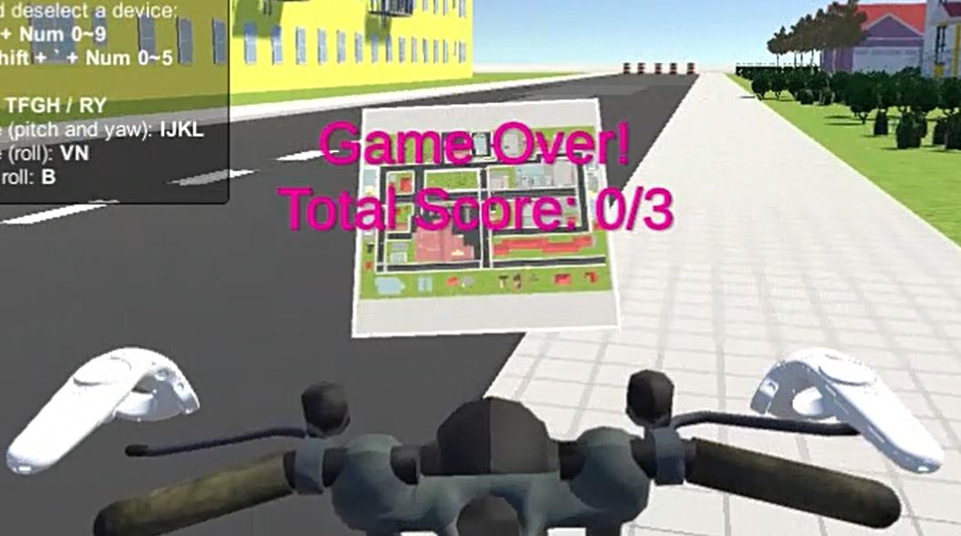
1. Description
Success Criteria
Failure Criteria
Delivering all pizzas on time
Time out

Slide 5
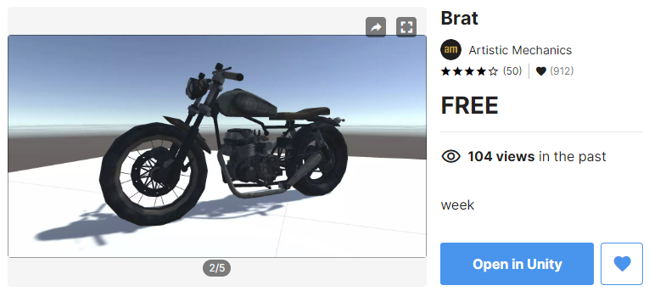
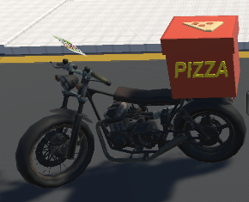
2. 3D Modeling

Slide 6
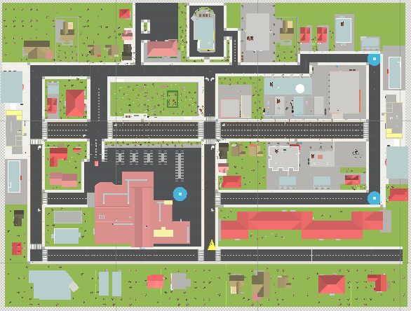
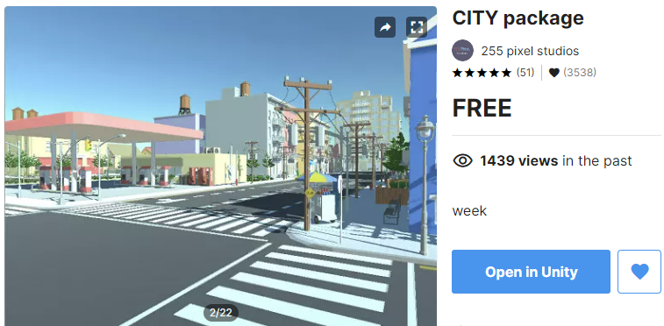
2. 3D Modeling

Slide 7
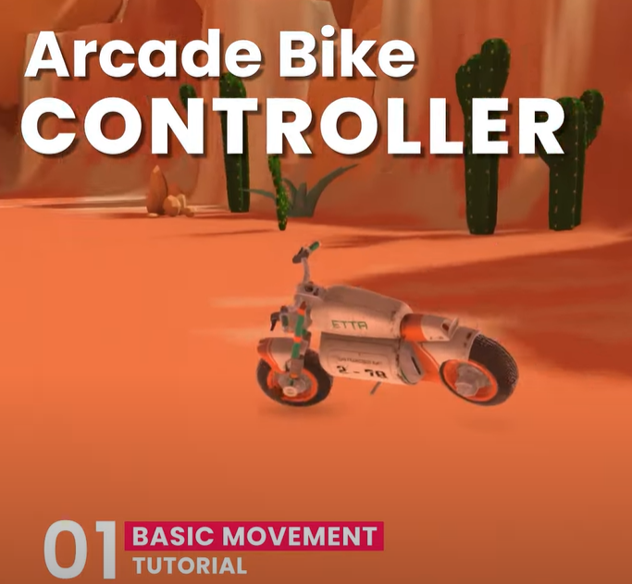
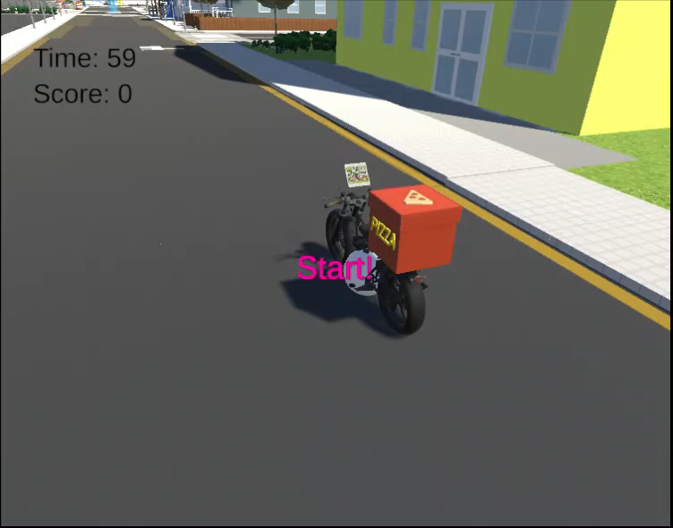
3. Motorcycle Driving
Arcade Bike Controller Part 1~3 | Unity tutorial | Ashdev

Slide 8
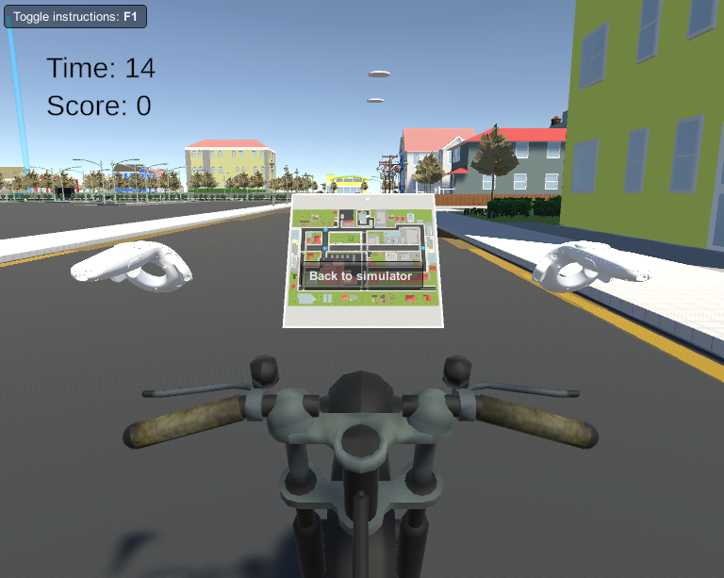
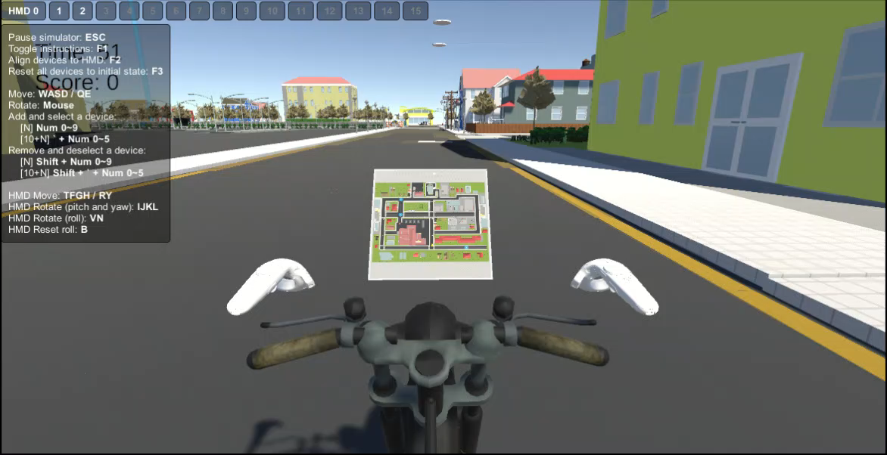
4. VR Functions

Slide 9
Thank You!

